Slide 1
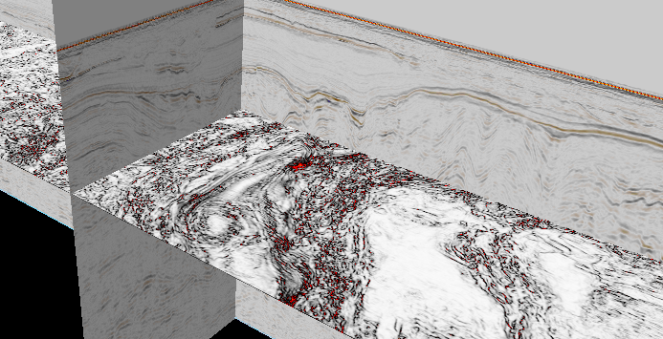
Seismic reflection data Lecture 4
Dr Rebecca (Becky) Bell and Raul Adriaensen
2nd floor, office 2.37a
rebecca.bell@imperial.ac.uk

Slide 2
Learning outcomes summary
Thanks for your feedback
A number of you are feeling a bit lost in all the detail from Tuesdays lectures
We have produced a new recorded lecture summarizing key learning outcomes from lectures 1 to 3- these are the key things you need to understand from this course
If you understood the concepts in Tuesday’s lectures you don’t need to watch this- there is nothing new, it just summarises key points

Slide 3
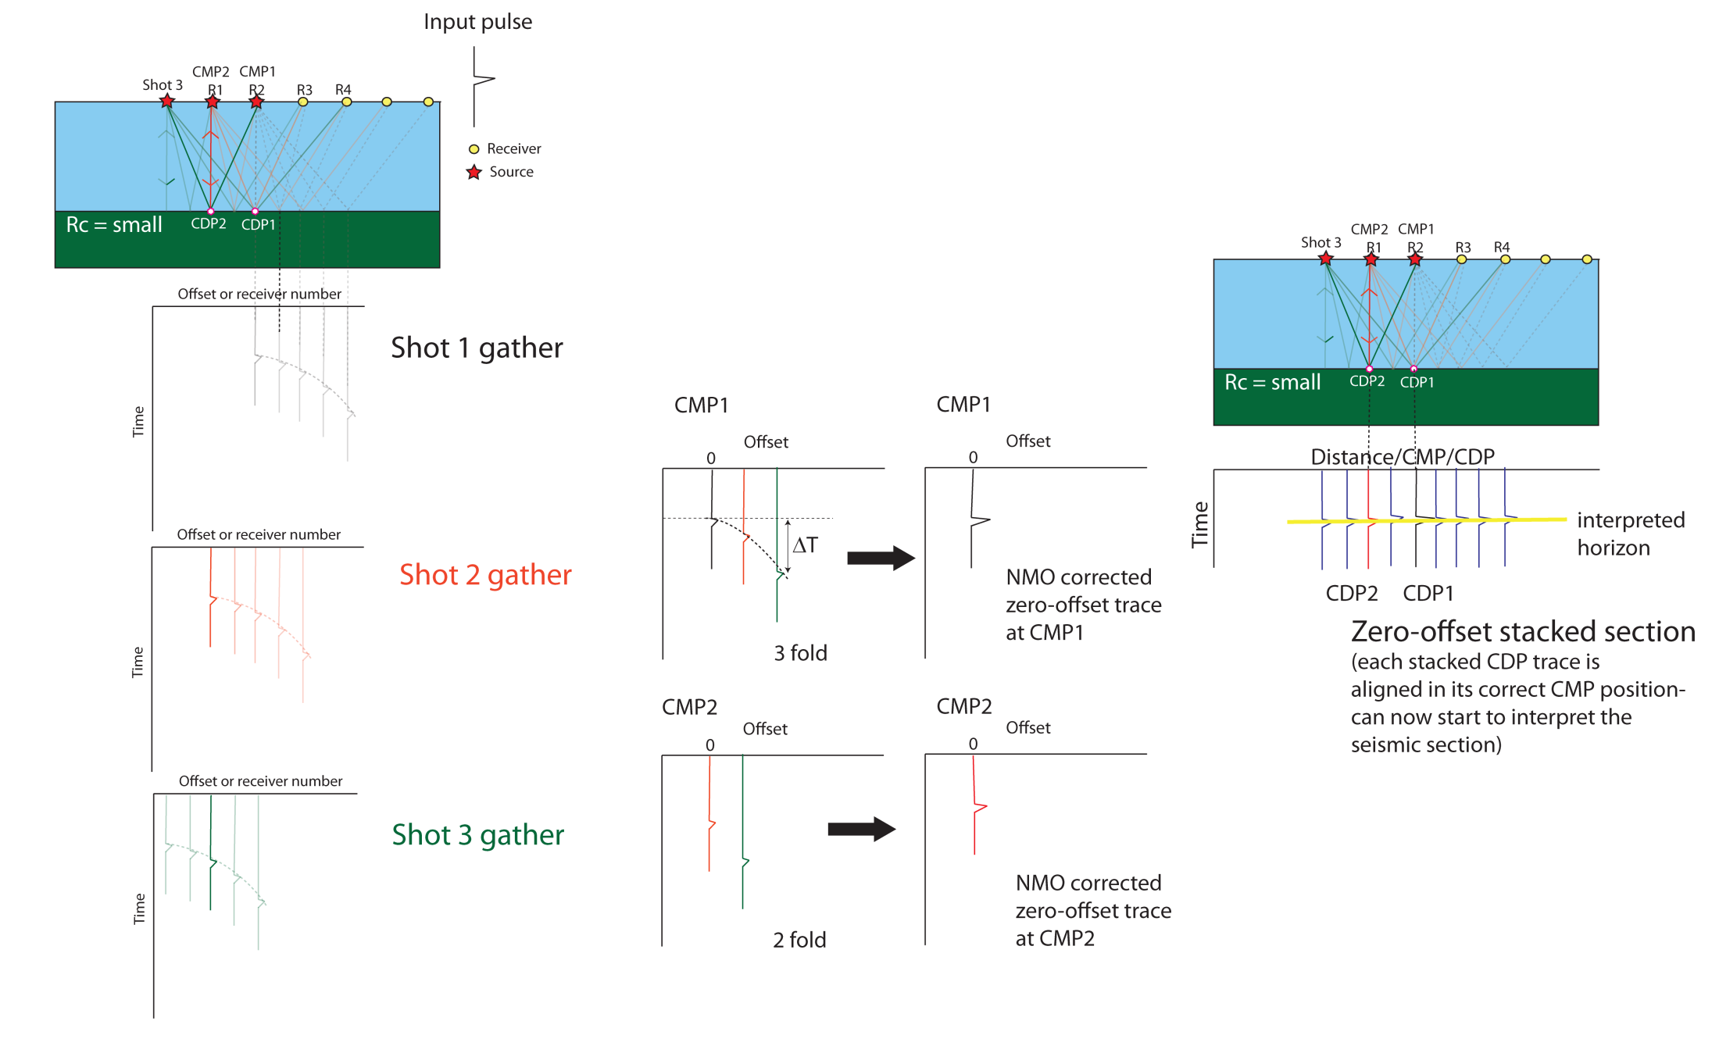
RECAP
Tuesday- data collection and processing
Thursday- stacked, fully
processed seismic data

Slide 4
Module outline
Day 2 morning- Visualising and interpreting seismic data
Lecture 4: The SEG-Y data convention and where to find data
Lecture 5: How to interpret seismic data
Lecture 6: Seismic attribute analysis and machine learning (future outlook)
Day 2 afternoon- Exercises
Exercise 3: Reading SEG-Y data and visualizing 3D data
Exercise 4: Calculating seismic attributes
Quick introduction to the assessment on 3rd Dec

Slide 5
Lecture outline
Objective of lecture 4:
Understand how to view seismic data and the SEG-Y file format
How seismic data is recorded and visualised
The SEG-Y file format
Open source SEG-Y data
Exercise 3- Visualising 3D seismic data with Python

Slide 6
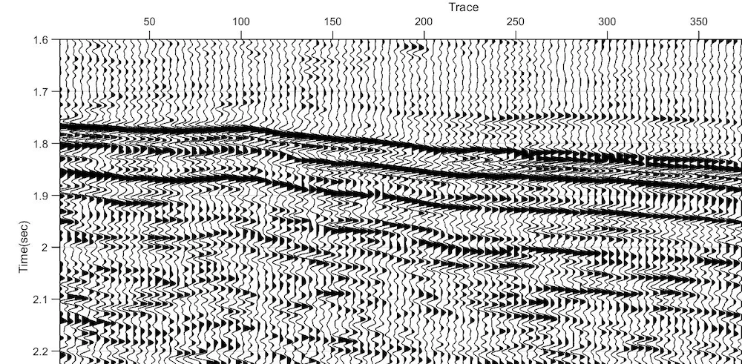
What is post-stack seismic data?
Once we have stacked seismic (‘post-stack’) (lecture 3) the traces can be considered as ’zero-offset’, ie we can think of the trace as recording normal-incidence reflections at the trace location.
For 2D data the traces will be spaced at the CMP/CDP interval
Fully processed seismic sections reveal the structure of the subsurface. The wiggles you see can be interpreted as geological boundaries…
https://www.mathworks.com/matlabcentral/fileexchange/51122-cqi_plotmatrix-data-varargin

Slide 7
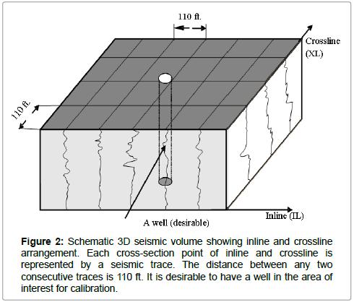
What is post-stack seismic data?
So a 3D seismic volume is effectively a grid of traces, with a trace at the intersection of every inline and xline.
3D data is commonly viewed as inlines (vertical profiles in the direction the data was recorded), xlines, time/depth slices (horizontal slices) or arbitrary lines
Chesnokov et al. 2017

Slide 8
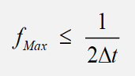
Sampling (Digitization)
The seismic traces are not recorded continuously. The continuous (analogue) signal is recorded discretely (sampled) at a constant time interval
The time interval (Δt) must be chosen to allow the analogue signal to be reconstructed from the sampled values
The maximum frequency (f_{max}) to be preserved must satisfy the Nyquist criterion:
This is the minimum sampling (maximum time interval) to preserve information in a signal

Slide 9
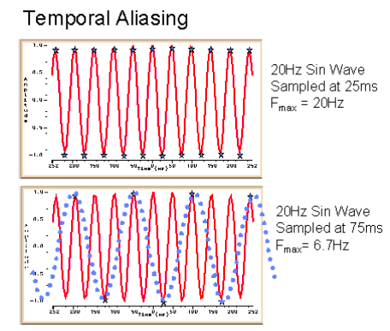
Temporal aliasing (time domain)
The top slide shows that a good representation of the 20Hz signal can be made by samples taken every 25ms (marked by the blue stars).
F_{max} = 1/2d =1/ 2*0.025 = 20 Hz
In the bottom slide samples are taken every 75ms. An insufficient number of samples are taken and the higher frequency information is "lost" or aliased. The original 20Hz red curve appears as a 6.7Hz blue dotted curve.
F_{max} = 1/2d =1/ 2*0.075 = 6.7 Hz
Before the data are sampled the higher frequencies which would be aliased by the chosen sampling interval must be removed by an analogue filter in the recording system.
http://www.xsgeo.com/course/acq.htm
Notes:
Signals cant be regenerated from aliased measurements. Not capturing the high freq parts of the signal

Slide 10
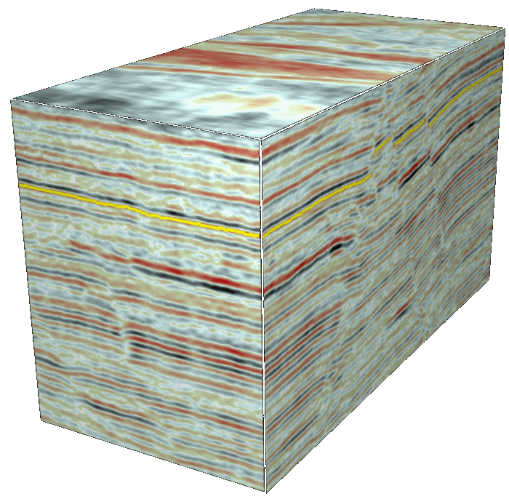
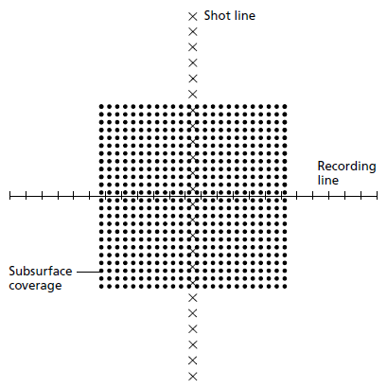
3D seismic: How big is it?
A 10 km x 10 km (100 km²) 3D survey at 25 m CDP interval contains 400 x 400 traces which equals 160,000 traces…
…the majority of 3D surveys now have CDP intervals of 12.5 m resulting in 640,000 traces per 100 km2 dataset!
Time samples are recorded at every 4 ms for crustal-scale surveys (not near-surface surveys), so a single trace covering 4 secs in time = 1000 samples resulting in 6.4 x 10⁸ samples for our 100 km² 3D seismic survey.
3D seismic volumes can range from a few 100 Mb to 10’s or even 100’s Gb

Slide 11
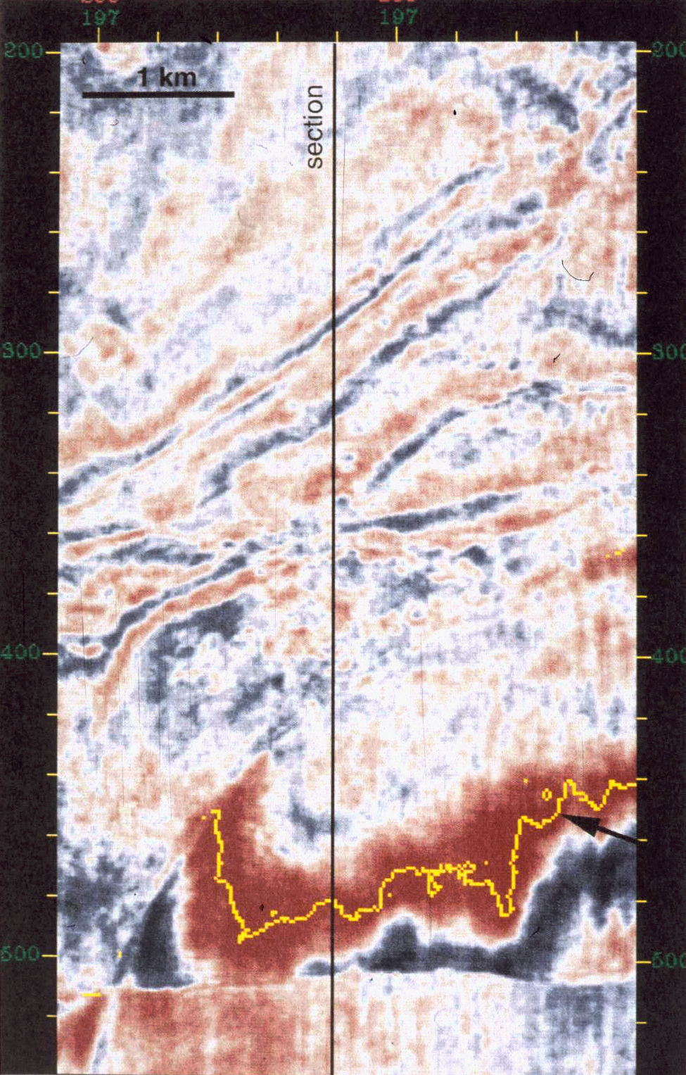
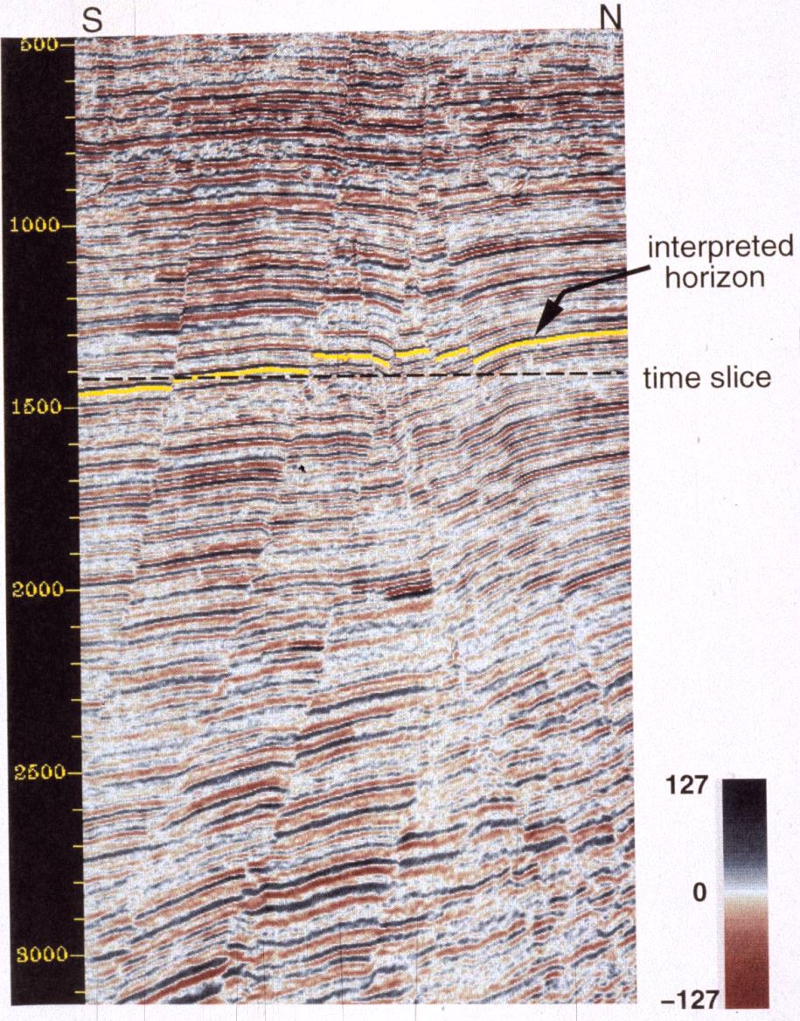
3D seismic: How do we view it?
This timeslice (left) and vertical seismic section (right) come from the same dataset in the Gulf of Mexico. Note the development of normal faults and mapped seismic horizon (yellow) on the vertical section which manifest as discontinuities and a broad mapped event respectively in the timeslice.
Confusing? Being able to reconcile the geometry of structures and mapped events is a key technique in 2D and 3D seismic interpretation…
Time slice at 1420 ms
Vertical seismic section

Slide 12
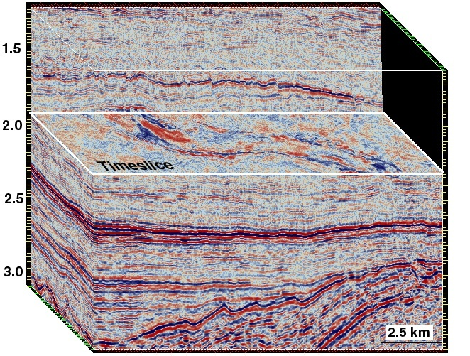
3D seismic: How do we view it?
Understanding of the relationship between features observed in vertical and map-view (timeslice) seismic sections can be aided by using 3D visualisation packages. In the example to the right from the Northern North Sea a chair display is used to observe the relationship between the cross-sectional and map-view seismic expression of a channel.

Slide 13
3D seismic: How do we view it?
Understanding of the relationship between features observed in vertical and map-view (timeslice) seismic sections can be aided by using 3D visualisation packages. In the example to the right from the Northern North Sea a chair display is used to observe the relationship between the cross-sectional and map-view seismic expression of a channel.

Slide 14
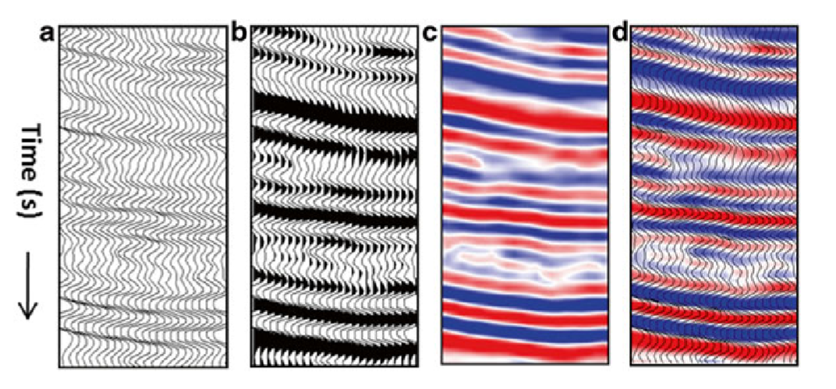
3D seismic: How do we view it?
Figure 6: Types of seismic data display modes: (a) Wiggle. (b) Wiggle and variable area.
(c) Variable density. (d) Combination of (a) and (c).
Niranjan 2016

Slide 15

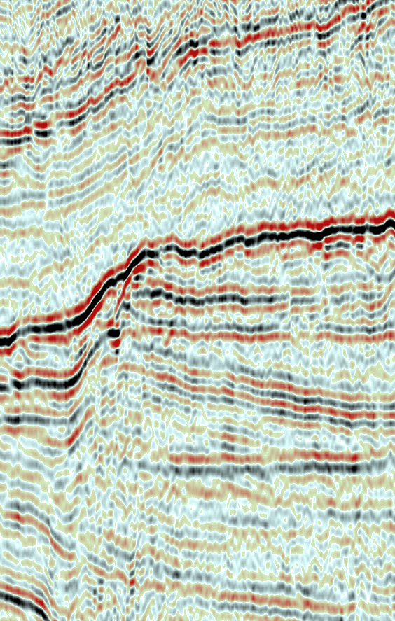

Dynamic range
Undercompressed colourbar
(poor use of dynamic range)
2) Suitably compressed colourbar
(perfect dynamic range)
3) Overcompressed colourbar
(poor use of dynamic range)
It is important to use the dynamic range of the data in the colour bar to display seismic data well

Slide 16
How are seismic data stored?
3D Post-stack seismic data are effectively a grid of samples. As a data scientist you may think this is quite a simple data type to store
However, seismic data storage has a long history dating back to 1975 when the SEG-Y file format was established for saving single-line seismic data to magnetic tapes (needed to make sure all the metadata stored with the trace data)
We still use the same file-format today, although it has been updated periodically
Not the most efficient file format for modern data science
In Exercise 3 the first thing you will do is convert SEG-Y data into a more efficient format (e.g. a numpy array)

Slide 17
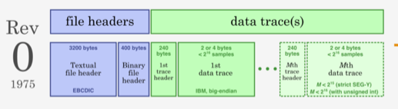
The SEG-Y file format
Developed by the Society of Exploration Geophysicists (SEG) released in 1975 for storing seismic data in a consistent way throughout industry
Built for reading and writing data to tapes, not for efficiently viewing inlines, xlines and time slices
The SEG-Y file mostly involves the trace data, but it also includes a number of headers: A text header, a binary header, a header for each trace
https://www.troika-int.com/about-us/resources/segy-seismic-data-exchange-format

Slide 18
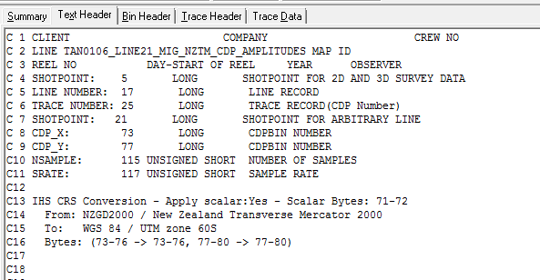
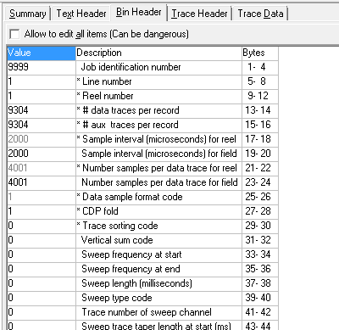
The SEG-Y file format
Text header: known as the EBCDIC. Human-readable header describing the data (bit like a ReadMe file). Contains information on acquisition, processing and geometry.
Binary header: values that apply to the whole SEG-Y file, e.g. sample interval and number of samples in each trace. In table form in 3 columns.

Slide 19
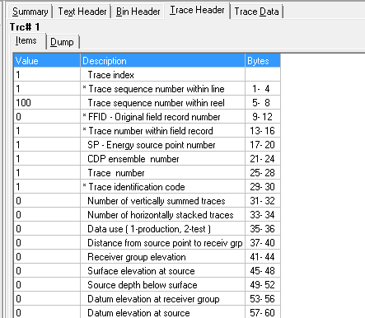
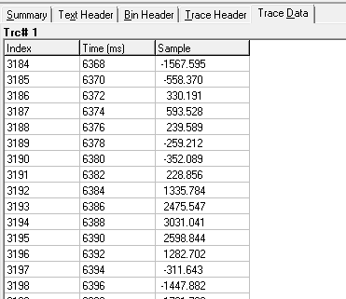
The SEGY file format
Trace headers: Each seismic trace has its own headers. Values change on a trace-by-trace basis. Cover details like CMP number, geographic location. The information in the trace header is stored in different “byte locations”.
Data traces: Depending on whether the data are 2D, 3D, 4D the traces will be organized in a particular order.
http://help.dugeo.com/m/learning/l/1002051-the-dug-insight-guide-to-seg-y

Slide 20
Challenges for data scientists
There are a number of tools available to convert SEG-Y data into a format
which is more efficient for viewing inlines, xlines, time slices and for doing
calculations with it. We are going to use segyio in Exercise 3.
The size of SEG-Y data makes it difficult to work with on an individual workstation.
In Exercise 3 we will work on a 500 Mb subset of a 8Gb data volume (TNW_small2.segy)
Groups are working on web API’s to host data in the cloud and allow people to
access parts of the data quickly and easily (e.g. oneseismic)
Data loading problems will occur if the data is not a perfect cube and inline/xline
spacing not regular. You will explore this in Exercise 3 and this may be an issue if you
download data from an open-source repository
Not all SEG-Y files will contain all the information you expect (the metadata quality will
vary between files…)

Slide 21
How can we access seismic data?
Seismic data is often proprietary when first collected
After a moratorium period academics and industry are often required to make the data open access (some countries are great at insisting on this- e.g. Geoscience Australia)
There is no single centralized location to access these datasets
The SEG wiki have a good summary of many repositories for open SEG-Y data- https://wiki.seg.org/wiki/Open_data
The Marine Geoscience Data System is a good option for academic datasets

Slide 22
Exercise 3
Explore the SEG-Y file format using three different 3D seismic data volumes
You will load and visualize 3D SEG-Y data in terms of inlines and xlines and time/depth slices
You will visualise the data in 3D using Mayavi
Fix data loading issues (NOT needed for the assessment)

Slide 23

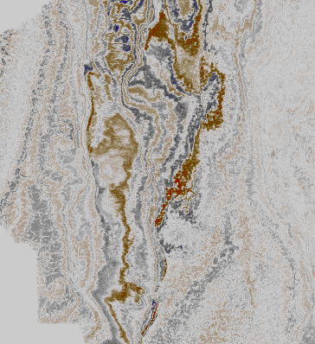
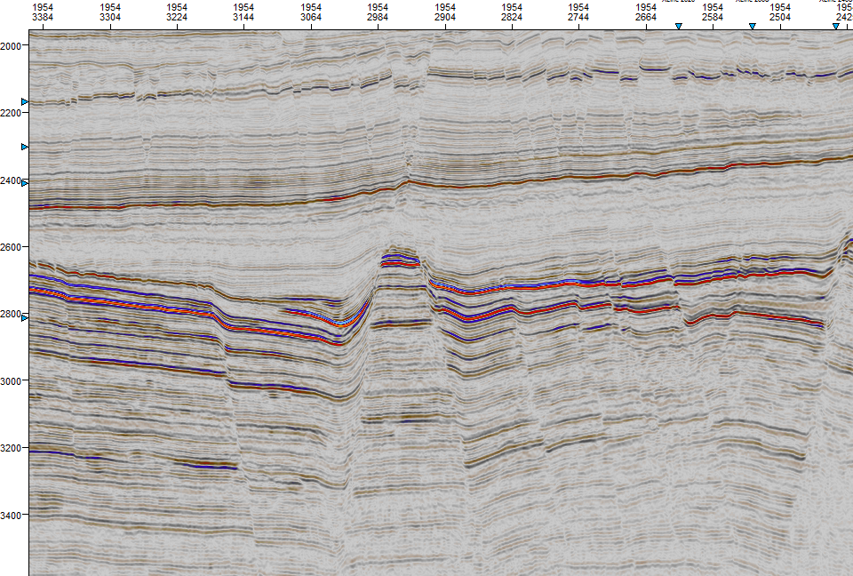
A
B

Slide 24
Learning outcomes
Appreciate how 3D seismic data are commonly visualized (inlines, xlines, horizontal slices, arbitrary lines)
Understand that seismic data in stored in the SEG-Y file format involving various header information as well as the trace sample data
Know some open-access repositories for downloading free SEG-Y data
Appreciate the key challenges of working with SEG-Y data
(primarily, huge file sizes)

